Slide 1

CMRM Project
Rhythm Wheel
Gerardo Cicalese
Giorgio Granello
16/06/2022

Slide 2
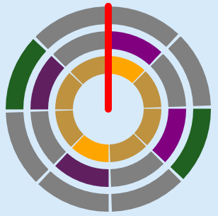
WHY a rhythm wheel?
Rhythm in music is characterized by a repeating sequence of stressed and unstressed beats.
In standard notation, rhythm is indicated on a musical bar line organized by time signature and tempo indications.
There are other ways to describe rhythm, which are more intuitive and can represent more various rhythms.
Just as a clock can trace the linear passage of time, the flow of rhythm can be traced on a circle.

Slide 3
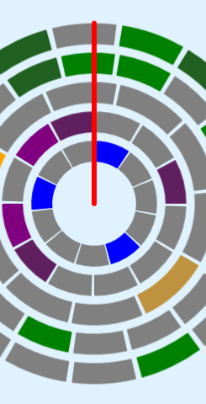
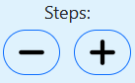
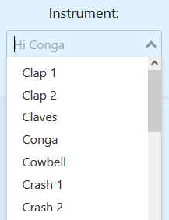
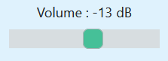
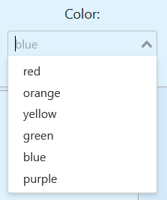
Ring
Audio library:
Tone.js
Library for UI components:
BootstrapVue
Our rhythm wheel is an array of rings.
Each ring is described by the following properties which the user can modify:
Rhythmic properties
Number of steps
Rhythmic pattern
Phase
Sound properties:
Instrument
Volume
Stress
Graphic properties
Color

Slide 4
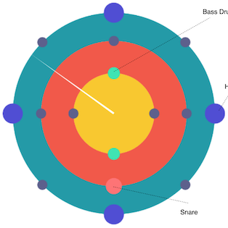
Restyling of the rhythm wheel
OLD
NEW
Graphics library:
Canvas

Slide 5

Easy to use
The main goal of our project is to make the experience of describing a rhythm as effortless as possible!
Thanks to our restyle we don’t have dots, but steps, making the web app easier to
use with a mouse.

Slide 6

Designed for polyrhythms
Polyrhythm is the simultaneous use of more rhythms that cannot be expressed simply within the same meter.
It’s difficult to describe polyrhythms with the standard music notation because it’s meant to represent just one meter.
In a rhythm wheel, each ring can have a different number of steps.

Slide 7

Connected to the cloud
GENERATION OF RANDOM RHYTHMS
The user can store his creations on the cloud and load them at a later time.
Don’t lose your rhythmic patterns anymore!
The user can ask the web app to create a random rhythm on-the-fly.
Our RNG takes environmental noise as an input.
We wanted to create a connection between noise (random sounds pressure fluctuations) and music (meaningful sounds).
Noise
Black box
Database library:
Firestore
Music

Slide 8

DEMO

Slide 9
THANKS for the attention

